Slide 1

Department of Electronic Communication Engineering
Real Time Project
Smart Automated Irrigation System
Guide name:
Mr. D. Srinivas
Submitted by:
R. Meghana – 23C31A04E5
R. Sanjana – 23C31A04E8
S. Rajesh – 23C31A04F8
V. Pravalika – 23C31A04H4

Slide 2
Content
Introduction
Types of Irrigations
Components used
Circuit diagram
Working
Advantages
Disadvantage
Application
Modern trends
Conclusion

Slide 3
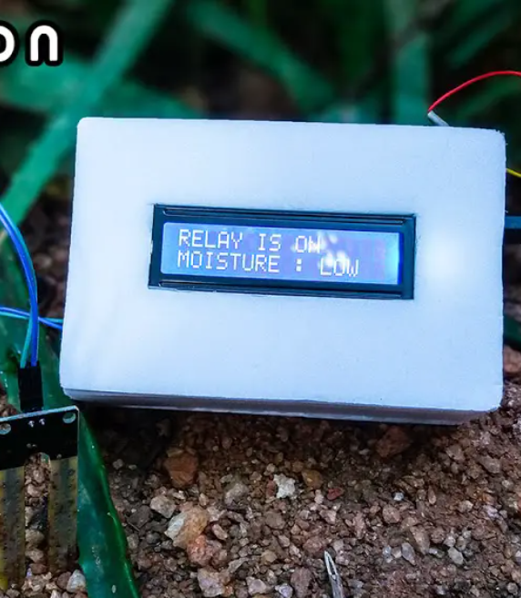
INTRODUCTION
Irrigation is an artificial supplying of water to the root of plant. In old methods, a lot of water is wasted in the process.
In a country like India, where the economy is mainly based on agriculture and the climatic conditions are isotropic, still we are not able to make full use of agricultural resources.
At the present era, the farmers have been using irrigation techniques in India.
through manual control in which farmers irrigate the land at the regular intervals.
Some of the sophisticated crops require fixed temperature light and other factors which are satisfied using different techniques.

Slide 4
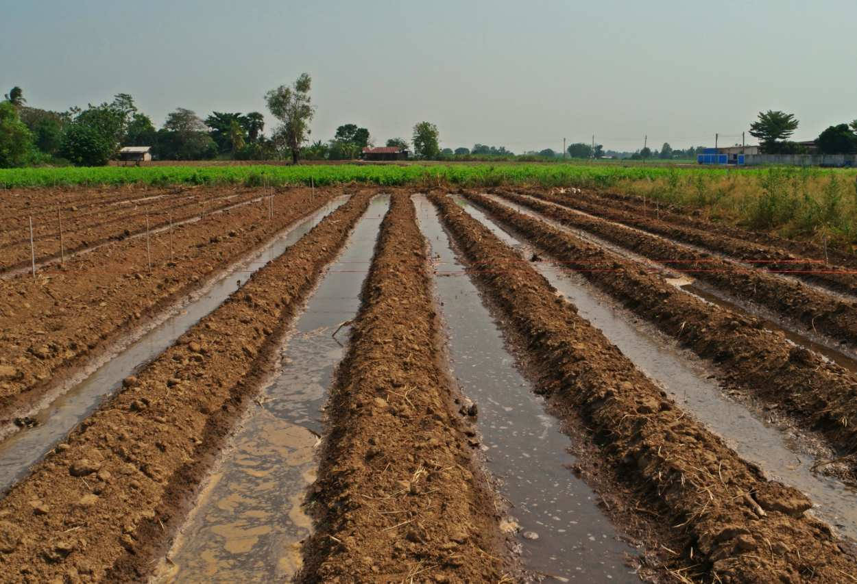
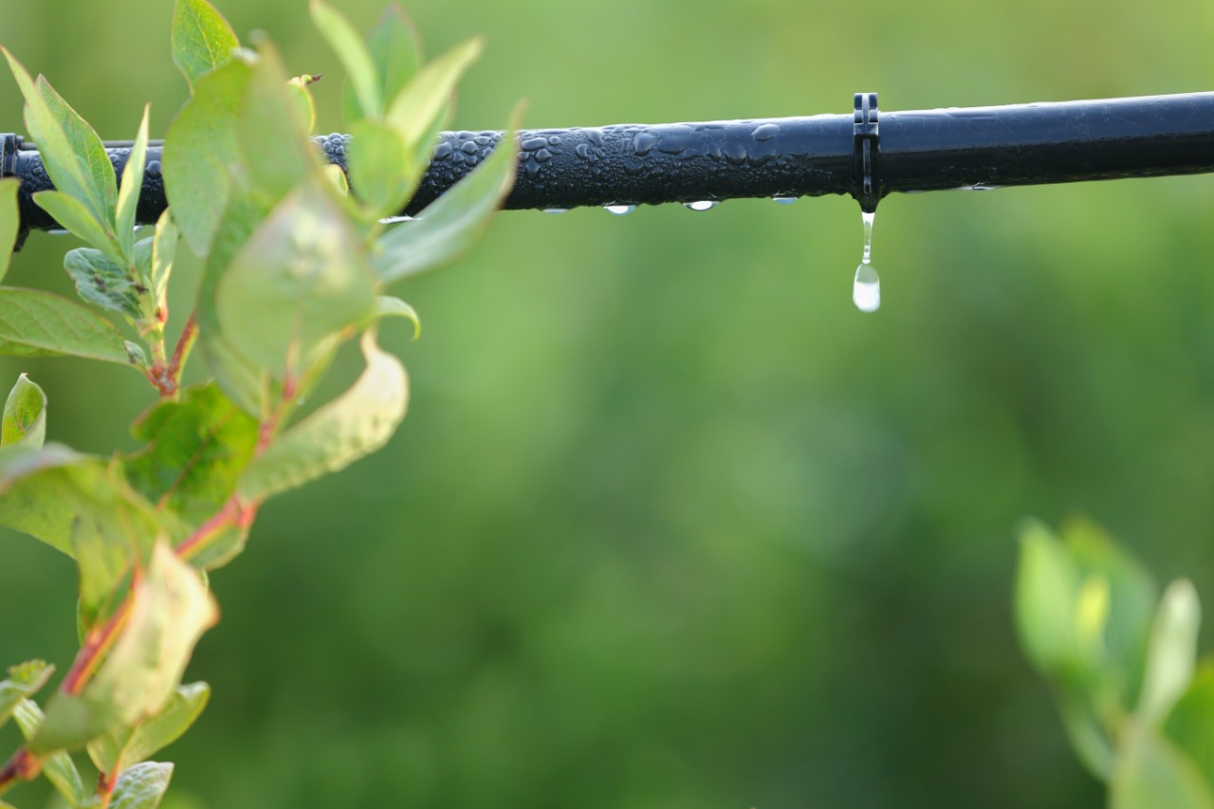
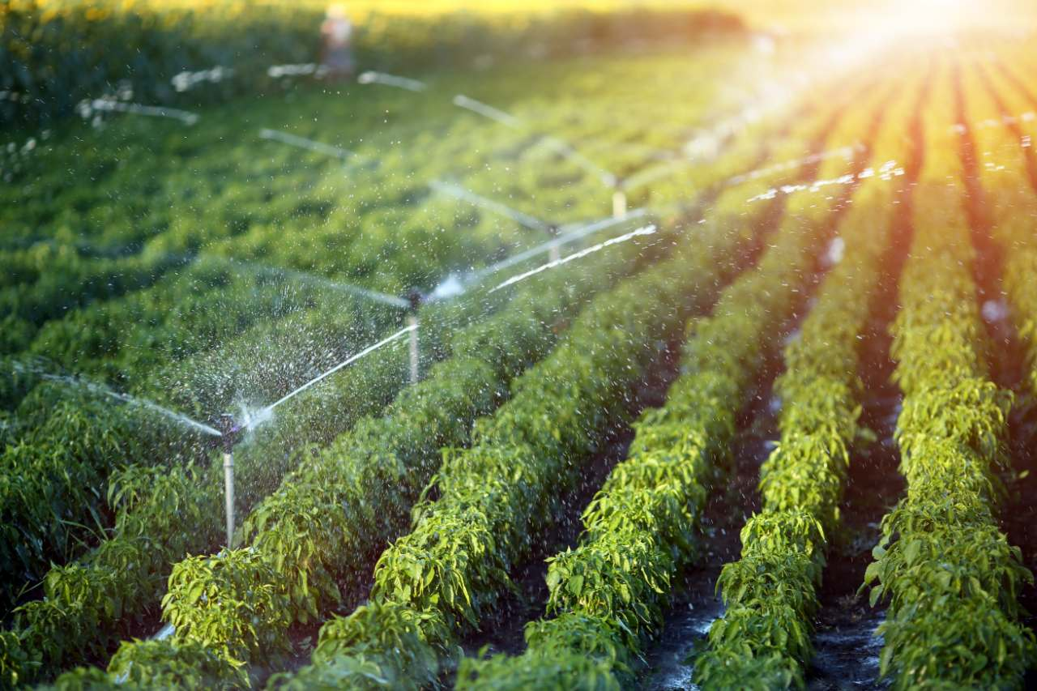
Types of Irrigations
Surface Irrigation
Drip Irrigation
Sprinkler Irrigation

Slide 5
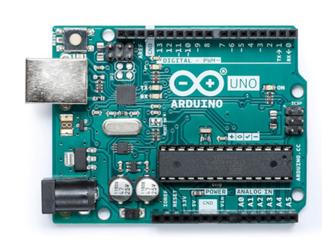
COMPONENT USED
Arduino Uno
Microcontroller board based on the ATmega328P.
14 digital I/O pins and 6 analog inputs.
Easily programmable via the Arduino IDE.

Slide 6
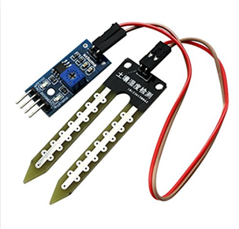
SOIL & MOISTURE SENSORS
Measures moisture using capacitance.
Operating voltage: 3.3V to 5V.
Temperature range: 0°C to 50°C.

Slide 7
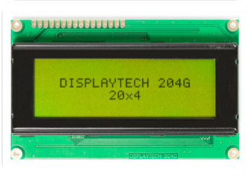
LCD
Displays up to 20 characters per line and has 4 lines.
User interface for input or selection.
Economical and easily programmable.

Slide 8
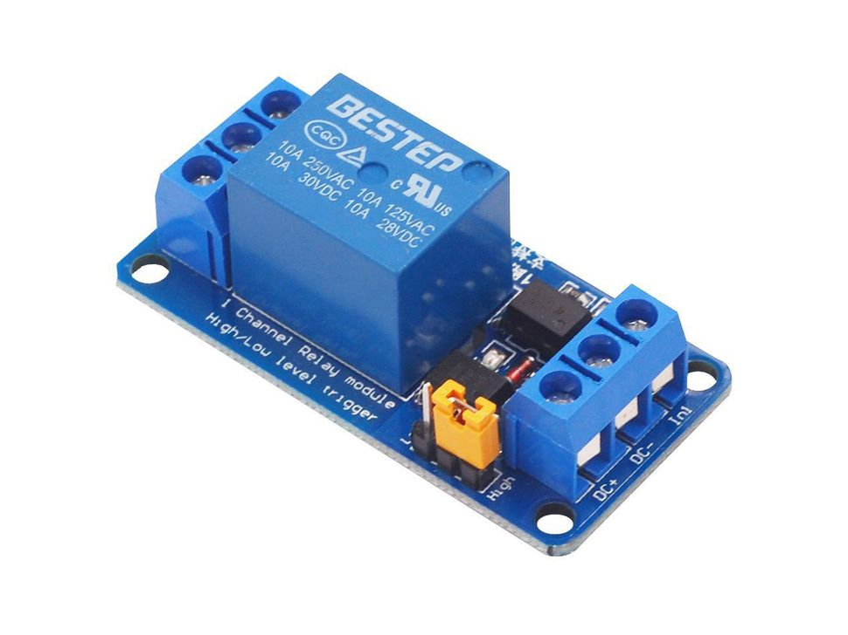
Relay
Switches high voltage with low voltage control.
Provides isolation between circuits.
Used in automation and appliances.

Slide 9
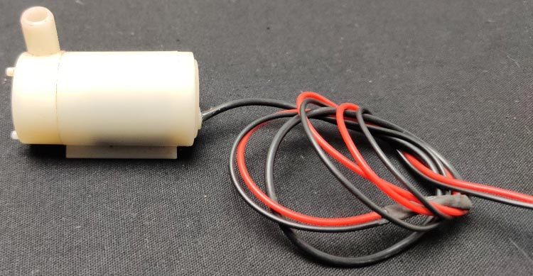
Water pump
Powers the water pump for irrigation.
Activated by sensor input when moisture is low.
Used in automation and appliances.
Controlled by microcontroller via relays or drivers.

Slide 10
WORKING
The Arduino Uno is used to control the motor, and it is programmed using the Arduino IDE to manage the system's operation.
The moisture sensor continuously monitors the soil’s moisture level and sends a signal to the Arduino when watering is required
The Arduino processes the moisture data and activates or deactivates the relay driver circuit based on the moisture level.
The relay circuit regulates the water pump, which supplies water to the plants when activated.
The LCD displays real-time system information, including the current moisture levels and pump status.

Slide 11
Advantages
Reduces water wastage by watering only when necessary.
Minimizes human intervention through automation.
Fit-and-forget system for hassle-free operation.
Works according to soil conditions, ensuring optimal watering.

Slide 12
Disadvantages
Sensor accuracy issues can lead to improper watering.
Continuous power consumption may increase energy costs.
Periodic maintenance and calibration are required.
High initial setup cost for components.

Slide 13
Applications
Roof of garden.
Lawn
Agriculture land.
Green city buildings.
Home gardens.
Indoor farming(vertical farming).

Slide 14
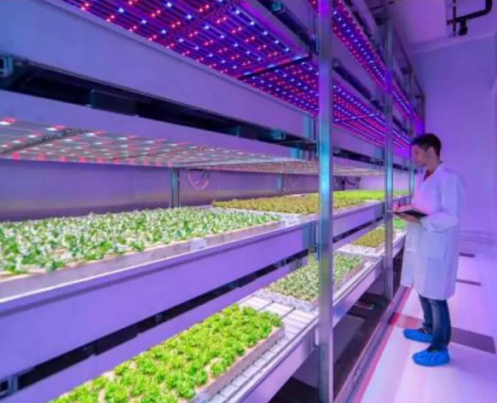
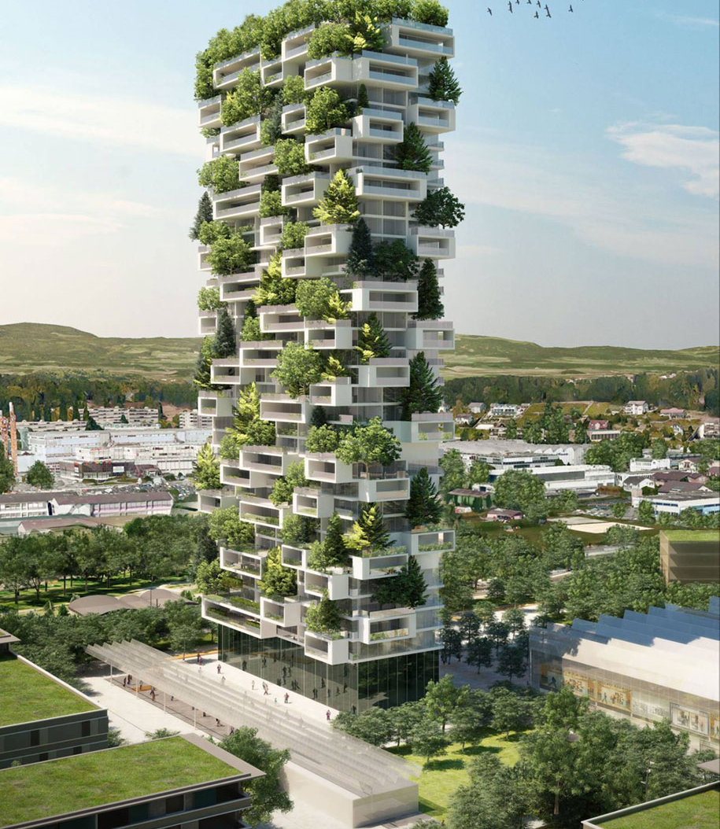
MODERN TRENDS
Indoor farming
Green Building

Slide 15
Conclusion
Maintaining plants during working hours or vacations is difficult, especially in cities, and farmers face challenges due to uncertain power availability for watering their fields.
Farmers also need to wait for fields to be properly watered, which prevents them from focusing on other tasks.
The automatic watering system solves this by sensing soil moisture and automatically switching the pump on when power is available, benefiting both farmers and gardeners.
The system can also cater to the specific weather conditions required for sophisticated crops, ensuring efficient irrigation.

Slide 16

Thank you

